Slide 1
Unemployment Rate Prediction
By Gopalakrishnan Kumar, MTech IIT-Bombay,
Freelance Data Science Consultant
LinkedIn: Profile Link : https://www.linkedin.com/in/gopalakrishnankumar-a73301110/
Github:https://www.github.com/Gopalakrishnan-Kumar/
Kaggle URL- https://www.kaggle.com/gopalkk2

Slide 2
Google Colab URL
https://colab.research.google.com/drive/10xjNoDeXpC4J4xMf4MmjxeVpHIrEl8dK?usp=sharing

Slide 3
Introduction
The unemployment rate is a vital macroeconomic indicator reflecting the health of the labor market and broader economy. Governments, businesses, and investors closely monitor unemployment trends to make informed decisions about fiscal policy, hiring, and investments. In this project, we leverage time series analysis using ARIMA to forecast unemployment trends based on synthetic monthly data (2010–2024).

Slide 4
Dataset Description
Frequency: Monthly
Period: January 2010 – December 2024
Variable: Unemployment Rate (%)
Data Source: Synthetic (normally distributed with mean ~6% and std ~1%).
Additional Data: A second synthetic dataset for Country B (mean ~5.5%, std ~1.2%)
was generated for cross-country comparison.

Slide 5
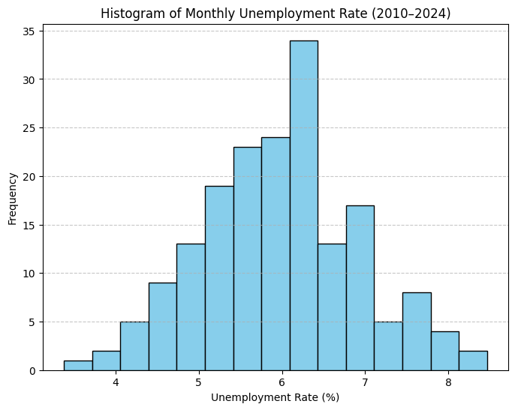
Data Visualization

Slide 6
Exploratory Data Analysis (EDA)
📊 3.1 Histogram
The histogram of unemployment rates shows that most values cluster around 6%, with moderate spread between 4.5% and 7.5%. This normal-like distribution suggests unemployment is relatively stable but subject to moderate fluctuations due to economic shocks.

Slide 7
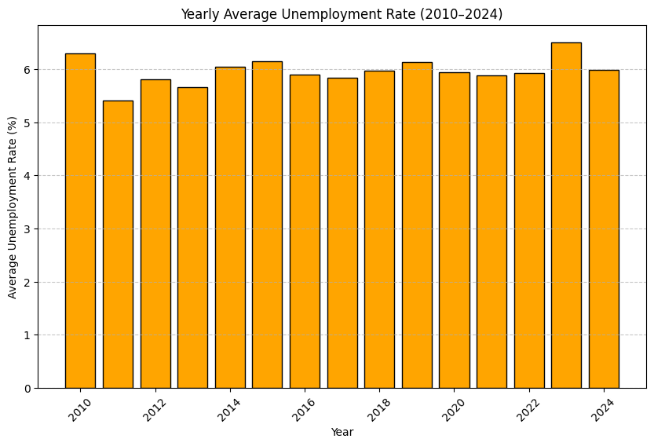
Data Visualization

Slide 8
Exploratory Data Analysis (EDA)
📊 3.2 Yearly Bar Chart
The yearly average unemployment rates highlight cyclical behavior:
Some years show slightly higher unemployment (above 6.5%), hinting at slowdowns.
Other years display lower unemployment (~5%), reflecting growth periods. This aligns with real-world labor markets, where unemployment follows business cycles.

Slide 9
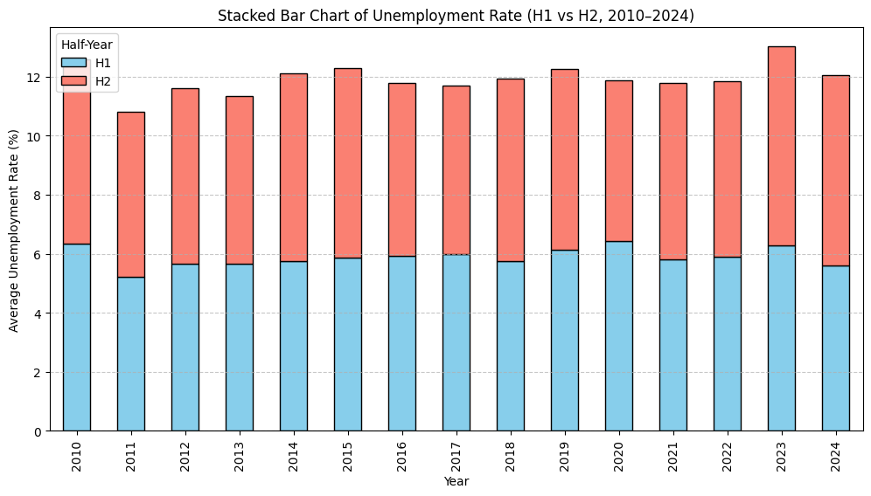
Data Visualization

Slide 10
Exploratory Data Analysis (EDA)
📊 3.3 Stacked Bar Chart (H1 vs H2)
By splitting into first half (H1: Jan–Jun) and second half (H2: Jul–Dec) of each year:
In many years, H2 had slightly higher unemployment, potentially linked to seasonal slowdowns after peak hiring.
Some years reversed this pattern, suggesting sensitivity to external shocks.

Slide 11
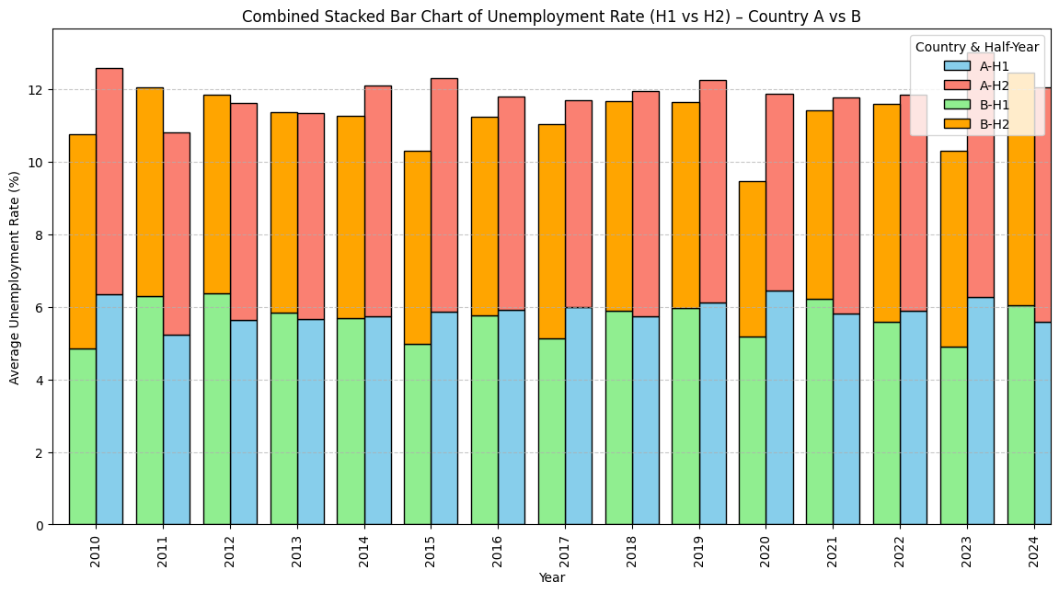
Data Visualization

Slide 12
Exploratory Data Analysis (EDA)
📊 3.4 Combined Stacked Bar Chart (Country A vs Country B)
The comparison revealed:
Country A averages ~6% unemployment, while Country B averages ~5.5%.
Country A consistently had slightly higher unemployment, but both followed similar cyclical patterns.
Divergences suggest structural differences in labor policies and industrial bases.

Slide 13
Forecasting with ARIMA
Model Used:
ARIMA(1,1,1) was selected after differencing the data to ensure stationarity.
This model balances autoregressive and moving average components effectively.
Forecast Results:
The 24-month forecast (2025–2026) projects unemployment to remain between 5.5% and 6.5%, consistent with historical averages.
Confidence intervals widen as time progresses, reflecting greater uncertainty.
No signs of extreme unemployment spikes or recessions were observed in the forecasted horizon.

Slide 14
Forecasting with ARIMA
Forecast Results:
The 24-month forecast (2025–2026) projects unemployment to remain between 5.5% and 6.5%, consistent with historical averages.
Confidence intervals widen as time progresses, reflecting greater uncertainty.
No signs of extreme unemployment spikes or recessions were observed in the forecasted horizon.

Slide 15
Key Insights
Stable Labor Market – Unemployment remained within a narrow range (~5–7%)
over 2010–2024,
and forecasts suggest stability will continue.
Seasonality Effects – A mild pattern shows unemployment slightly higher in the
second half of the year.
Cross-Country Comparison – Country B performed marginally better than Country A,
highlighting different economic conditions.
Forecast Confidence – The model provides reliable short-term predictions but
uncertainty increases with longer horizons.

Slide 16
Applications
Government & Policymakers: Plan welfare budgets, design job creation programs,
and adjust fiscal policies.
Businesses: Use forecasts to anticipate labor availability and wage pressures.
Investors: Align investment decisions with labor market stability.

Slide 17
Limitations
Synthetic Data: Results may differ on real-world datasets with
shocks (e.g., pandemics, wars).
External Drivers: ARIMA uses only past unemployment rates;
exogenous variables (GDP,
inflation, interest rates) were not included.
Seasonality: Stronger seasonal effects might require SARIMA for
monthly real-world data.

Slide 18
Conclusion
The analysis demonstrates that unemployment rates exhibit cyclical but stable patterns. Forecasting with ARIMA indicates that unemployment is expected to remain steady around 6% in the near future, providing reassurance to policymakers and businesses. While the synthetic dataset limits real-world accuracy, the methodology can be directly applied to official labor statistics for actionable insights.

